Slide 1
The Virtual Learning Center (VLC)

Slide 2
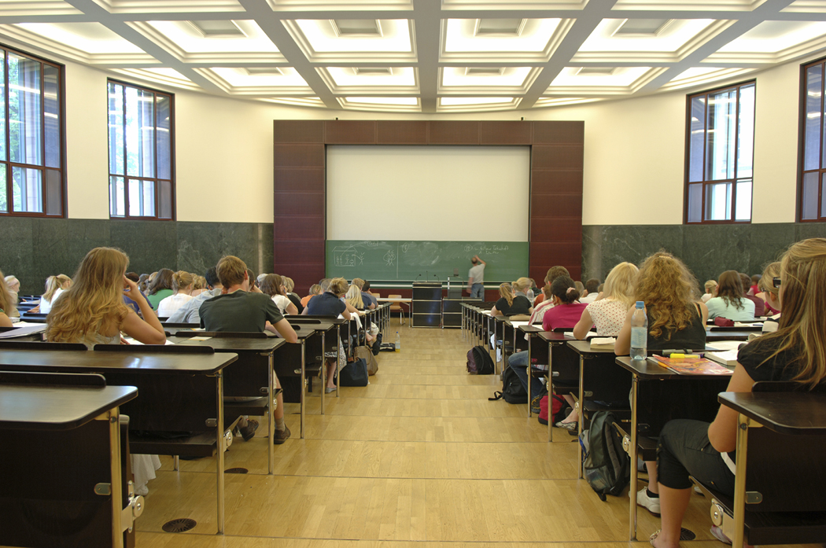
As educators,
today we are focusing on not just teaching,
but learning.

Slide 3
To increase the graduation
rate, more and more higher
level colleges and universities
are offering online classes as part of their curriculum.

Slide 4
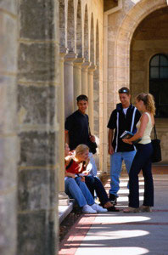
Universities like:
Harvard
Yale
Notre Dame
Dartmouth
Duke
Stanford
Vassar
Cornell
Brown
John Hopkins
William and Mary
Lehigh
and Wake Forest,
just to name a few.

Slide 5
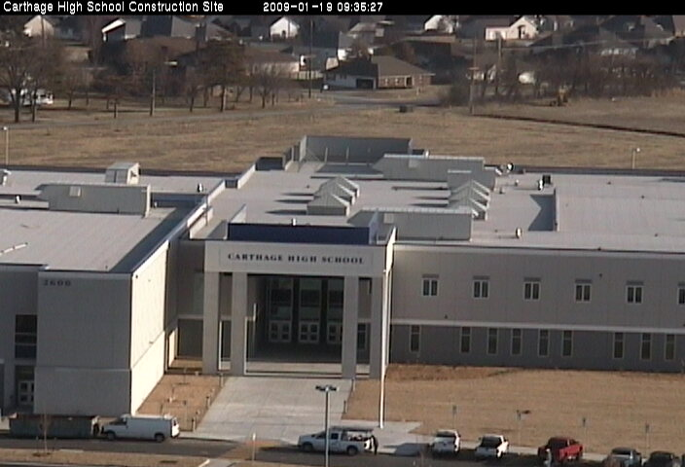
Now, so does Carthage High School,
through the Virtual Learning Center!

Slide 6
The Virtual Learning Center (VLC) provides flexible and innovative opportunities in differentiated instruction, always with the goal of graduation in mind.

Slide 7
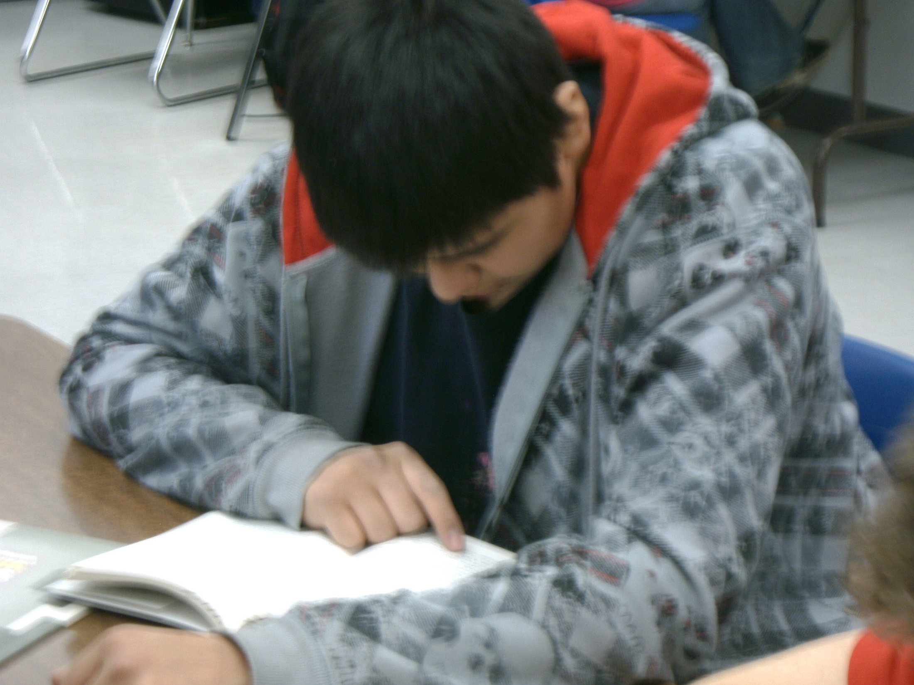
Students choose online classes for a number of different reasons.

Slide 8
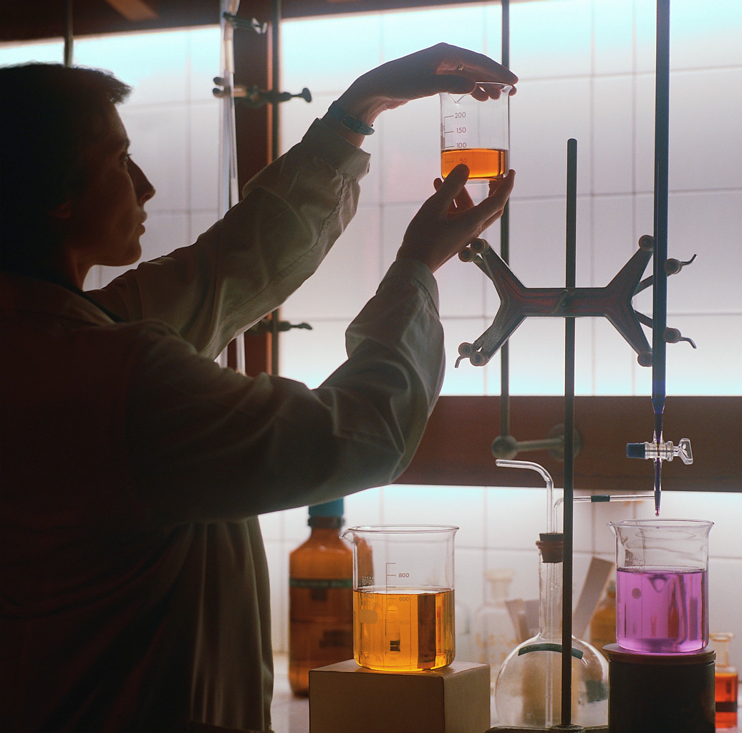
Some students have scheduling conflicts.

Slide 9
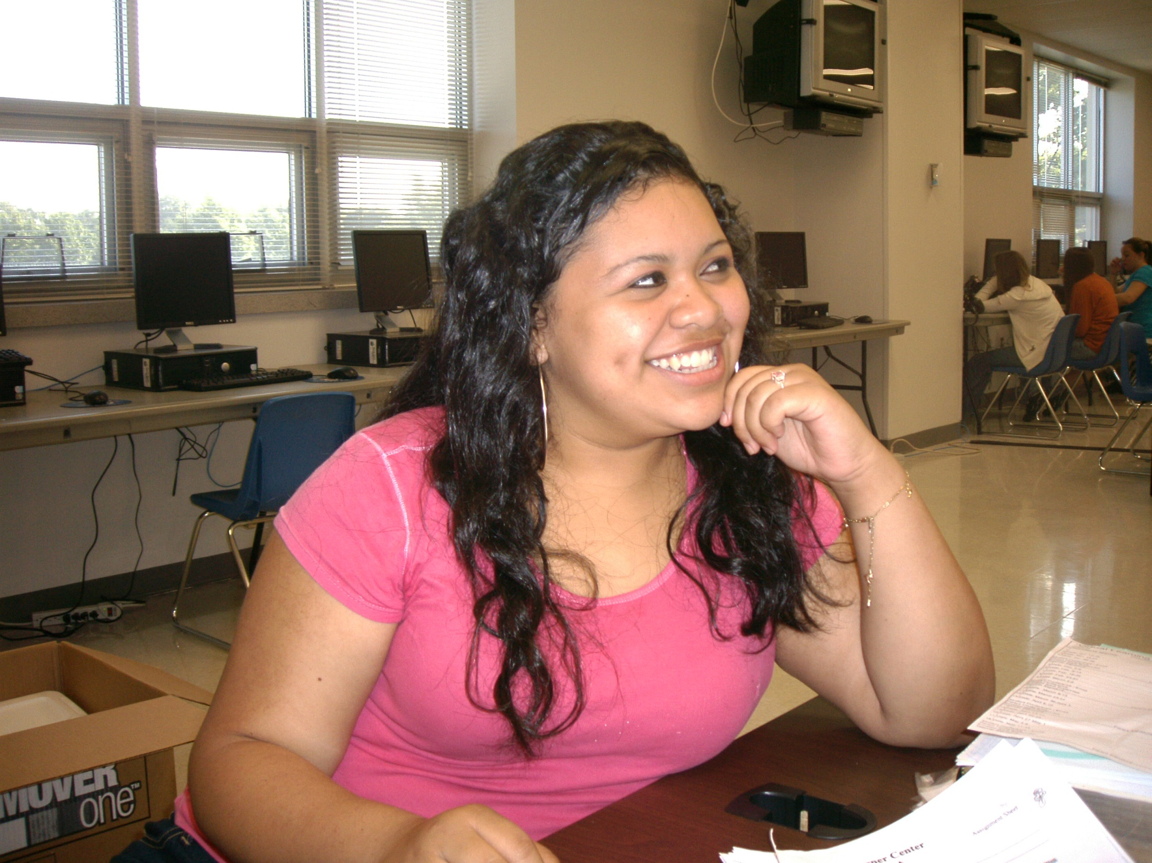
No problem!
Students can take classes at the
Virtual Learning Center whenever it
fits into their schedule.

Slide 10
There are many reasons why students need to catch-up on credits.
Extended Illnesses
Failed Classes
New Citizens
Transfer Students
Homeschooled
Homebound
Transient Students
The VLC is a great place to get that accomplished!

Slide 11
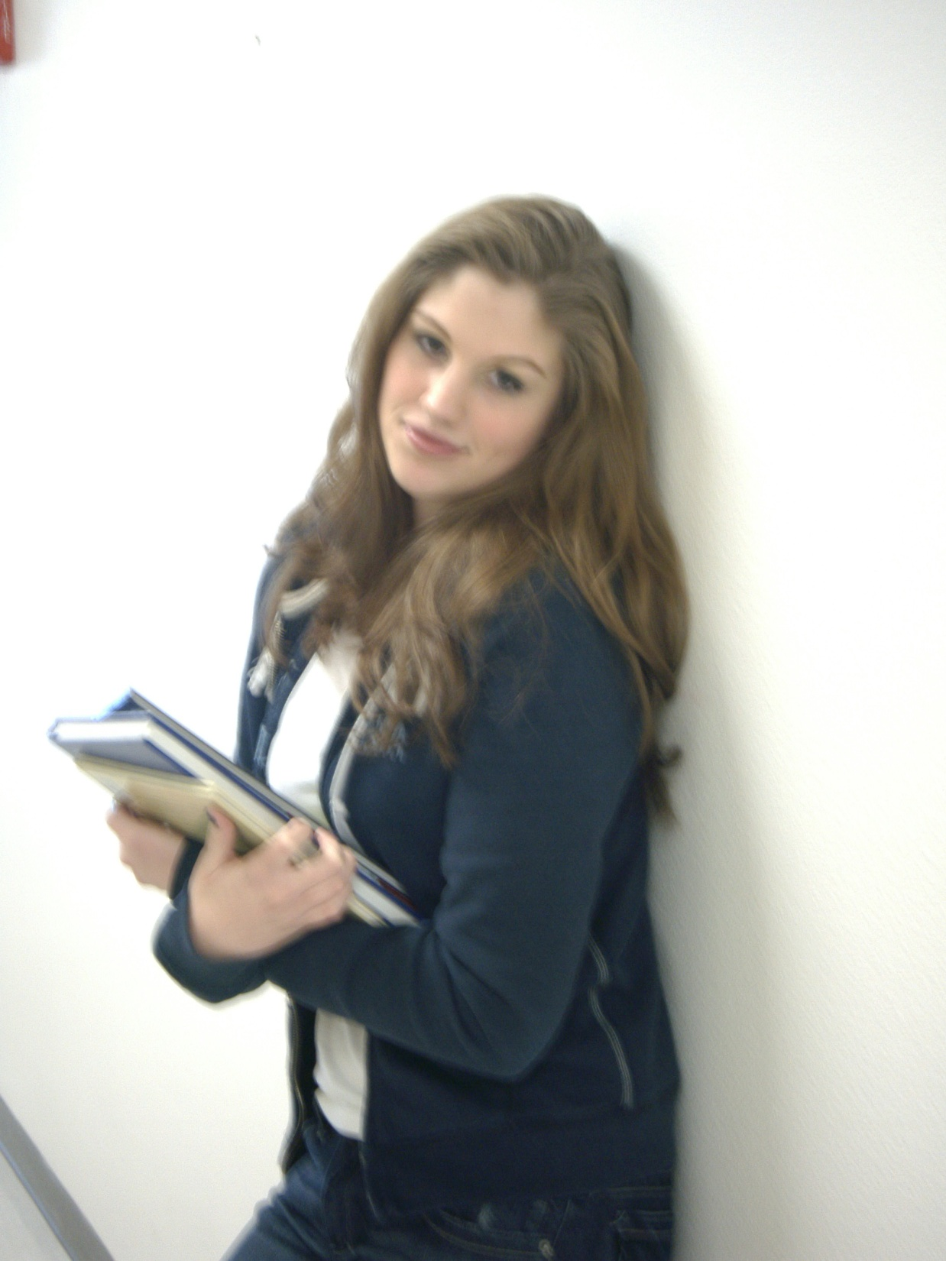
Some students want to graduate ahead of time.
The VLC can help with that too!

Slide 12
The VLC offers 50+ core and elective classes to ALL
Carthage High School
and sending school students.

Slide 13
VLC courses contain skill-based software that meets all
Missouri State Standards (MSIP),
Grade Level Expectations (GLE’s),
and Course Level Expectations (CLE’s).

Slide 14
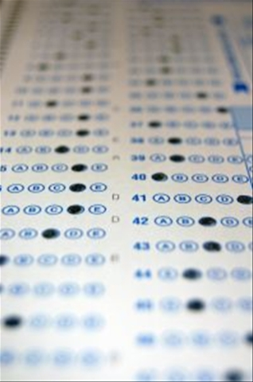
Content specific assessments are administered at the VLC in the form of review and final examinations. End of Course (EOC) examinations are given as well.

Slide 15
Virtual Learning Center classes are closely patterned after Carthage High School’s curriculum, and articulated through grade levels by scope and sequence.

Slide 16
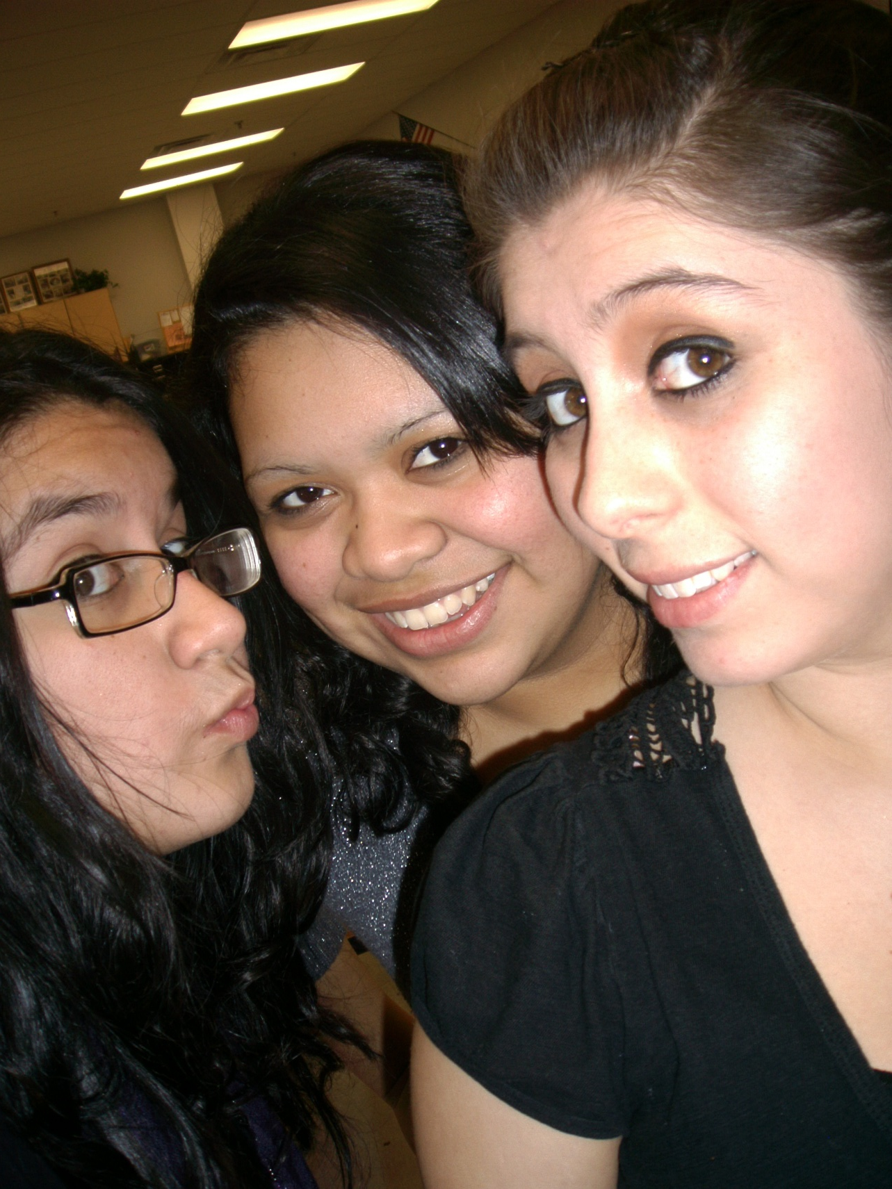
The Virtual Learning Center works closely with the Special Needs department and the English Language Learners department to create classes that meet the educational needs of each student.

Slide 17
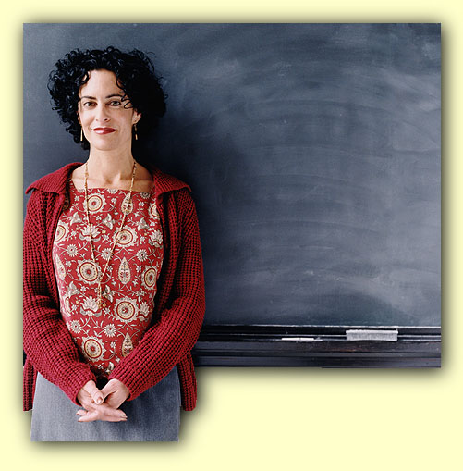
The VLC can also create tailor-made supplemental teaching materials to assist regular classroom teachers.

Slide 18
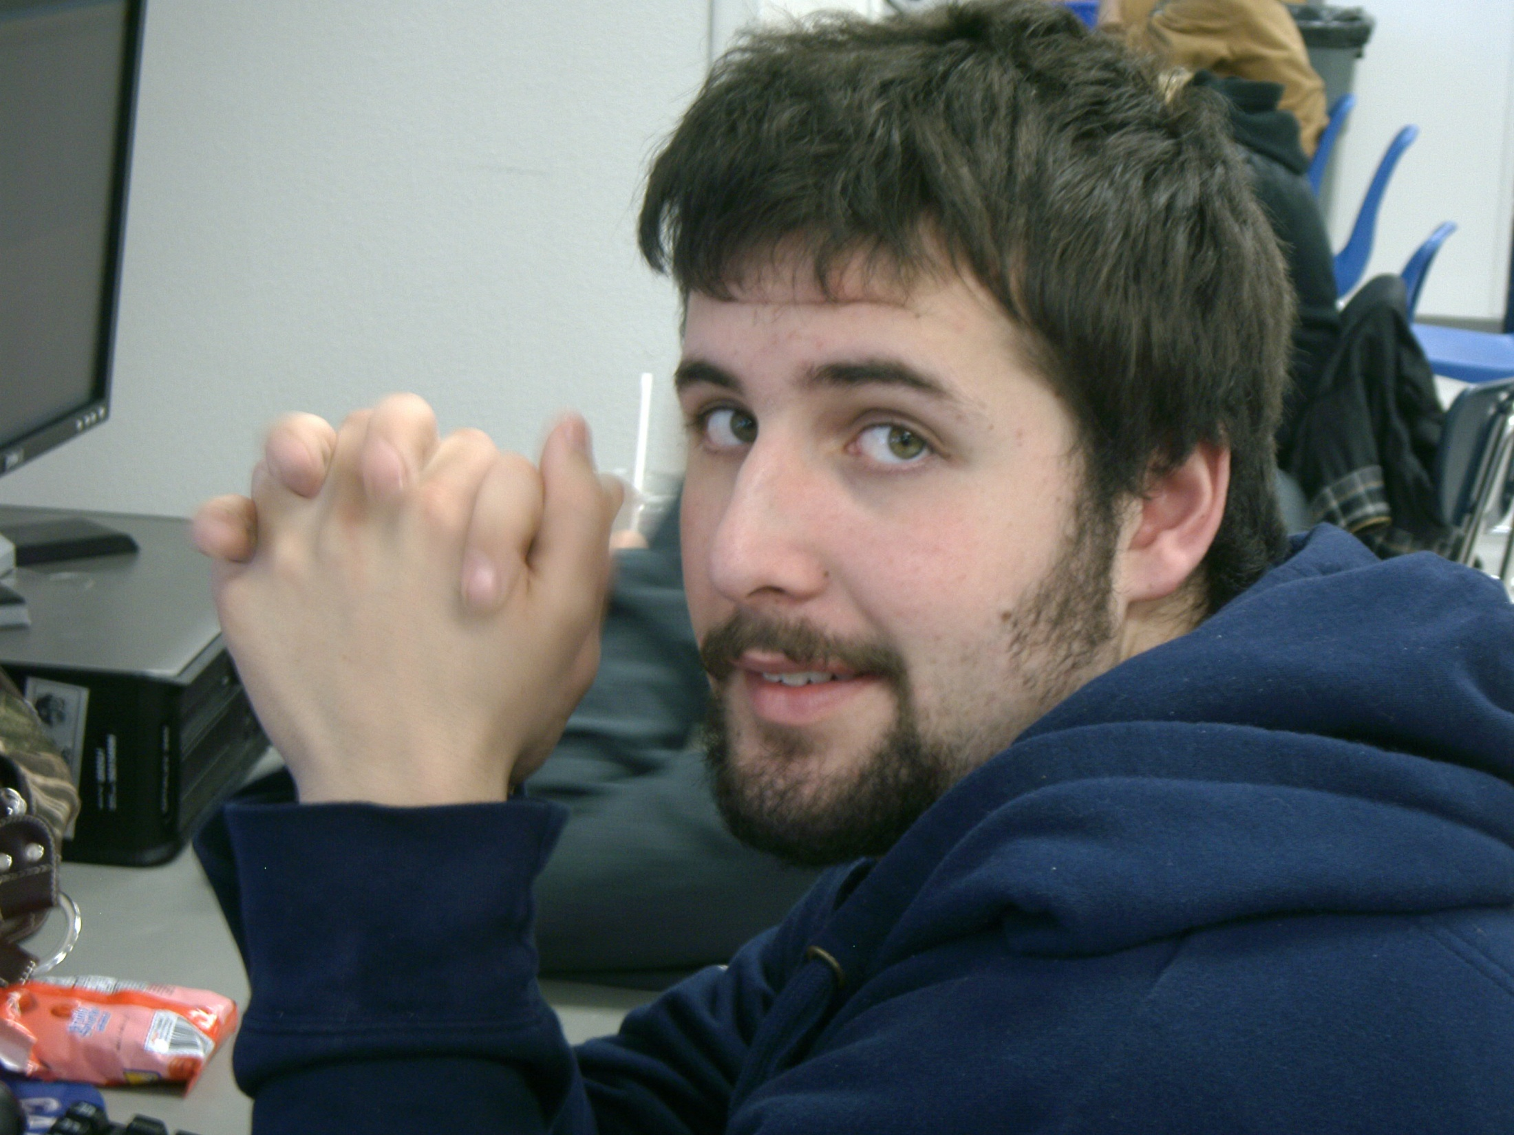
What can a VLC student expect?

Slide 19
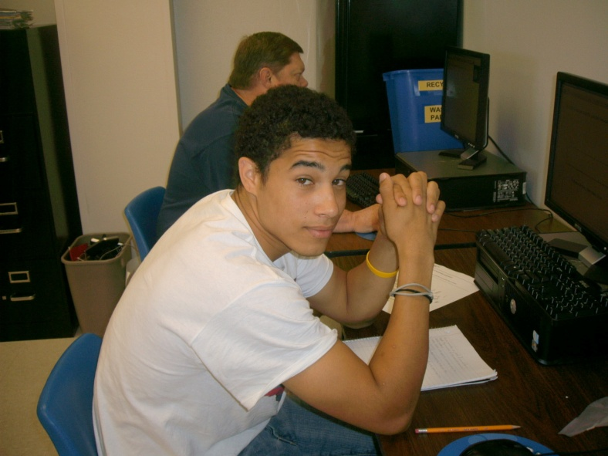
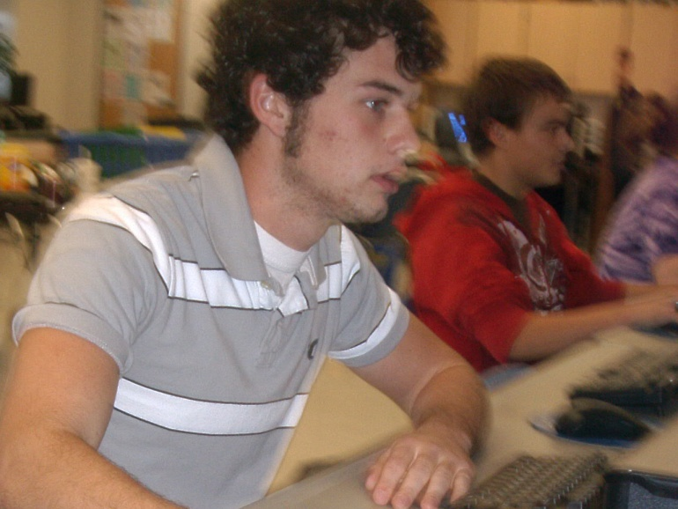
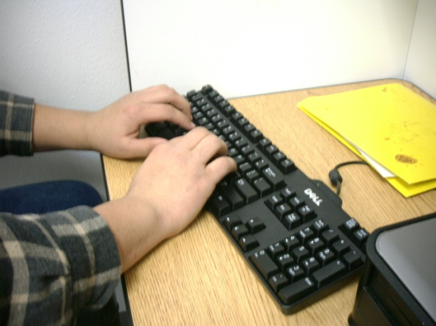
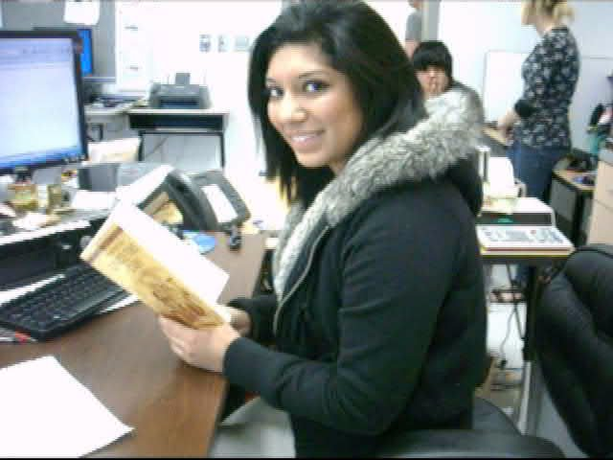
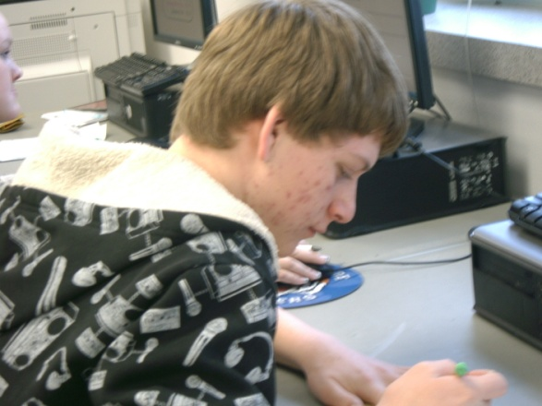
Online and Off-line Activities

Slide 20
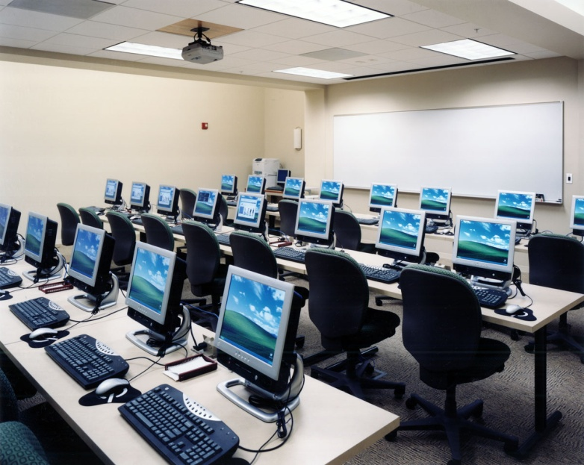
All Virtual Learning Center classes earn
½ credits toward graduation. Each
class incorporates not only Virtual
Prescriptive Learning (VPL) computer
instruction, but also a combination of
writing assignments, vocabulary work,
video and movie creations
and presentations, classic
novel readings, current
event summarizations,
worksheet practices, and
timeline formations.

Slide 21
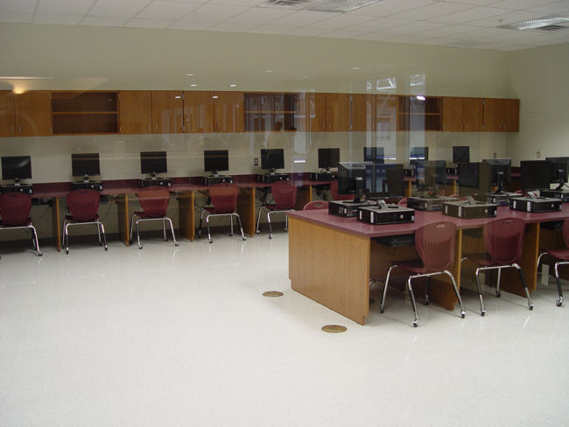
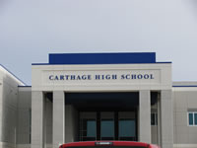
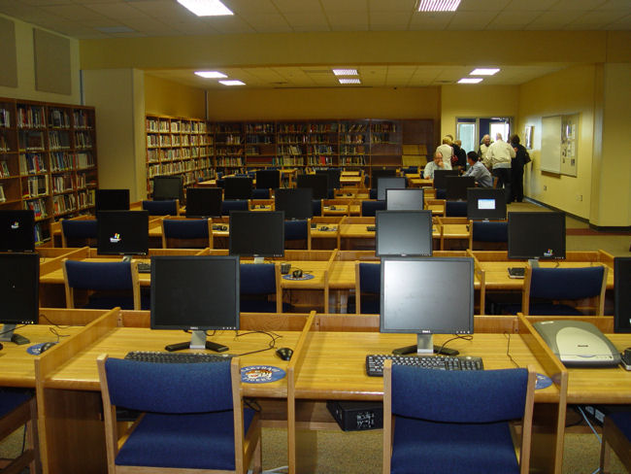
Various Work Locations
250+ workstations
Students can work on their Virtual Learning assignments on ANY school computer.

Slide 22
Weekly Progress Report
Students are conferenced as to their attendance and academic progress. This accountability tends to make a student more responsible and successful.

Slide 23
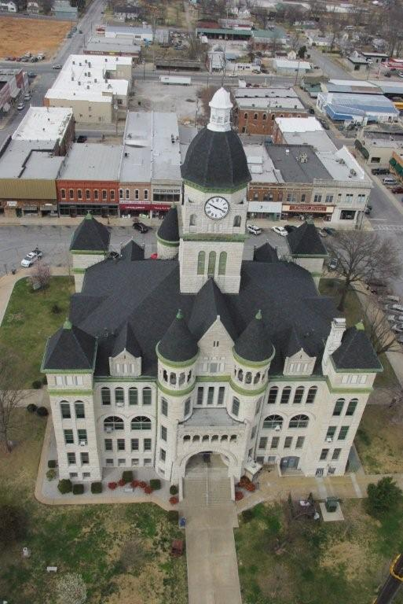
The VLC also offers the Missouri Options Program (MoOp)
MoOp was designed to assist students who have the capability to complete Missouri high school graduation requirements, but for a variety of reasons lack the credits needed to graduate with their class.

Slide 24
MoOp prepares students to prove their aptitude by successfully completing the Missouri equivalency test (GED), thus earning their high school diploma.

Slide 25
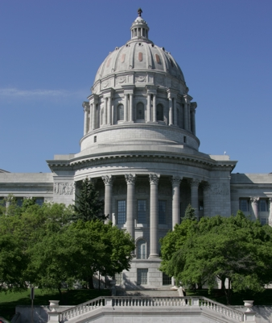
The Virtual Learning Center is a showpiece for the Carthage school system. Because of their unprecedented success, the VLC administration and staff were asked to present their educational techniques, procedural practices, record keeping, and statistical outcomes to a state-wide audience in Jefferson City.

Slide 26
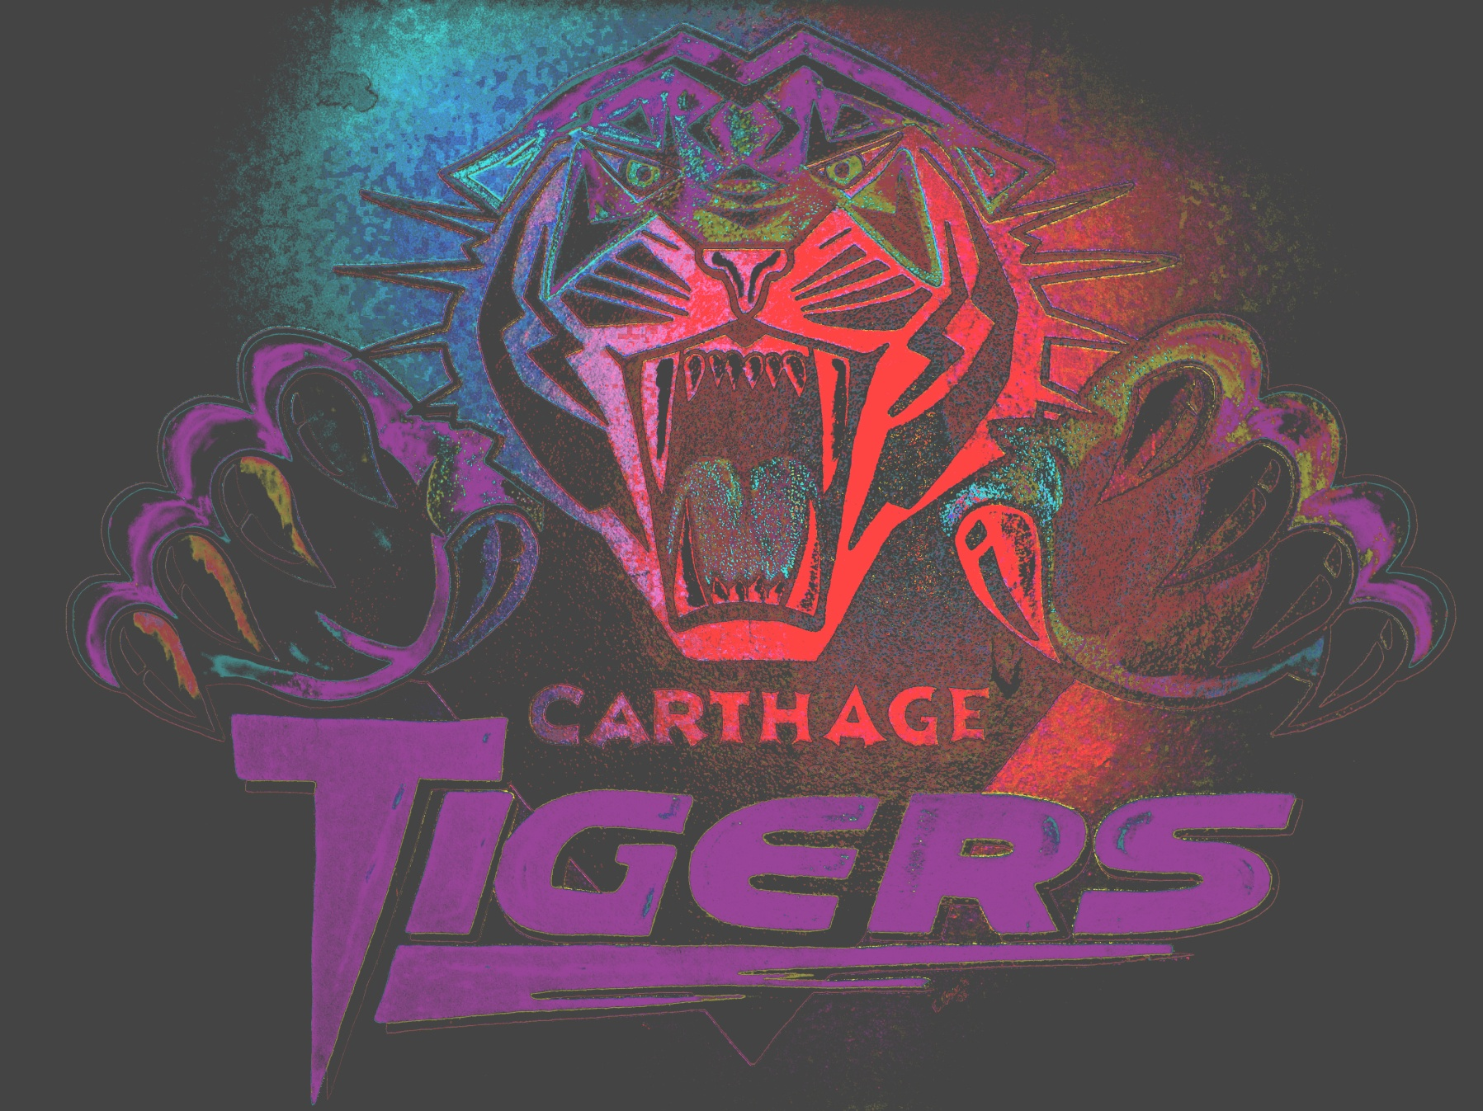
The Virtual Learning Center has a lot to offer

Slide 27
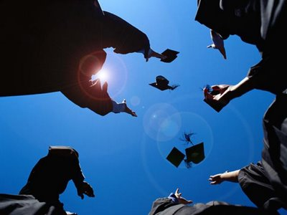
Online and Off-line Instruction
A Variety of Locations
Flexible Scheduling
Weekly Progress Reports
Missouri Options Program

Slide 28
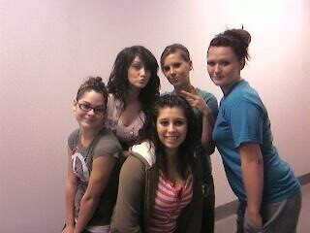
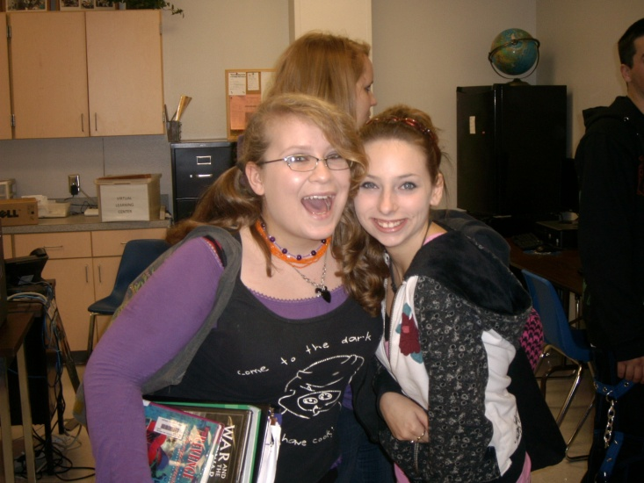
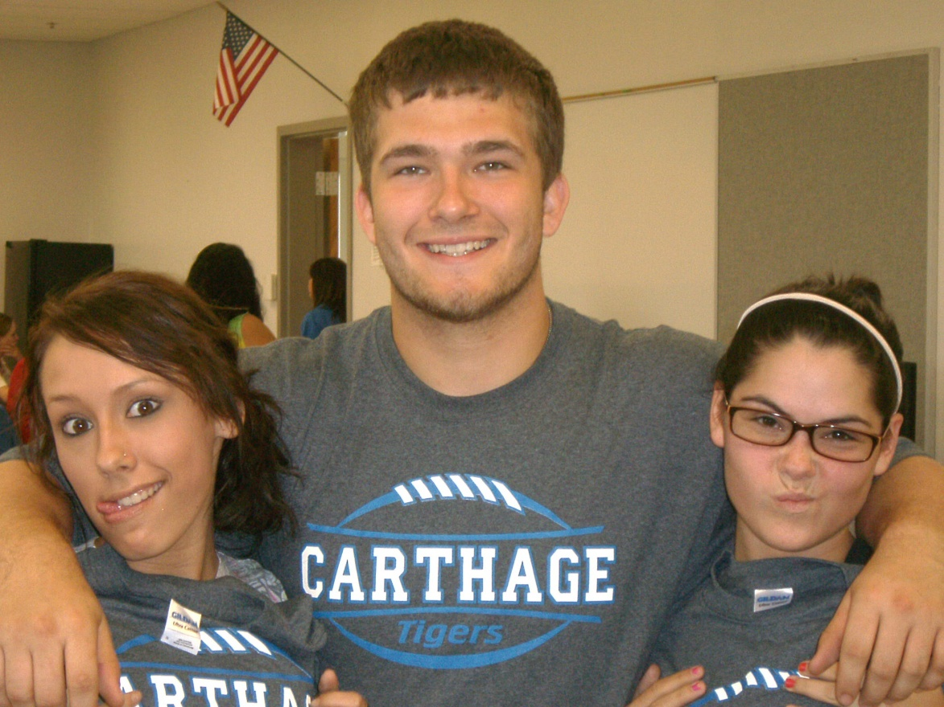
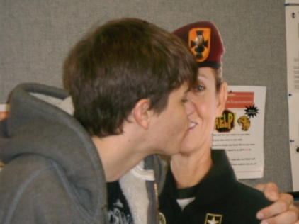
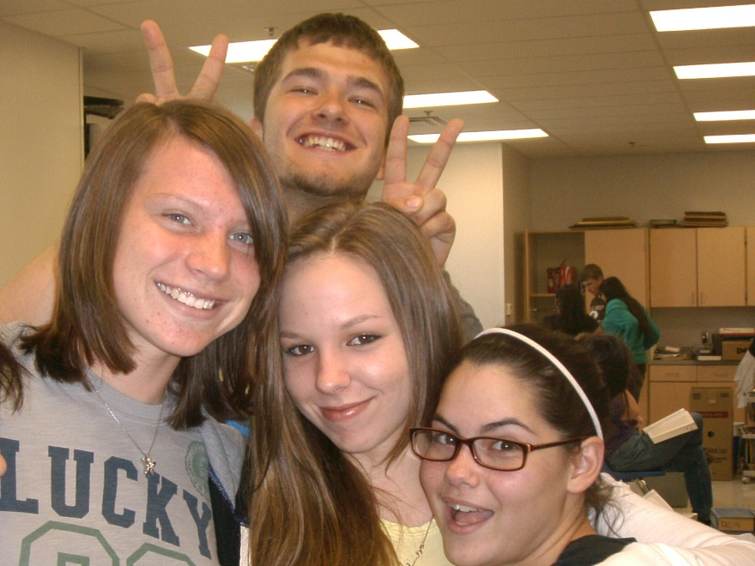
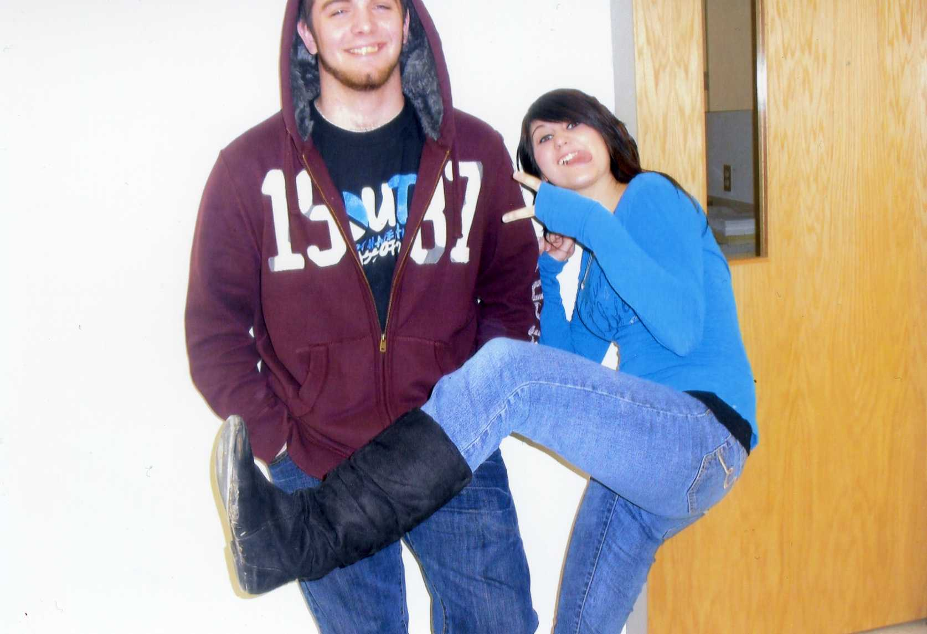
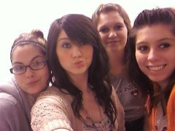
Along with all the opportunities available, students seem to really enjoy the atmosphere and style of learning at the VLC!

Slide 29
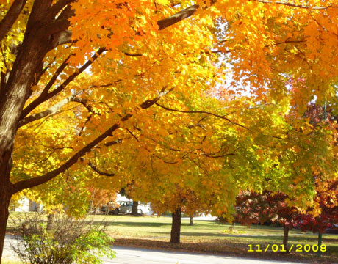
The Virtual Learning Center is an important part of what we do in Carthage to provide the best possible education for our students. “Graduation Matters”
to us, and to them.

Slide 30
VLC
IS
Carthage Proud

